Slide 1
CZ-AT Energy Group,
Prague, Febraury 2014

Slide 2
My lecture at opening the new direction, nuclear engineering,
at the
West Bohemian Technical University,
Pilsen, Czech Republic
September 2010
( The speech will be distributed in Czech and English)

Slide 3
Decisions about energy policy are a very difficult task. I usually illustrate this with two figures:
4 years versus 40 years
4 years is time for which a politician is in most countries elected to the parliament
40 years is a reasonable time horizon for planning our energy vision or strategy.

Slide 4


Slide 5
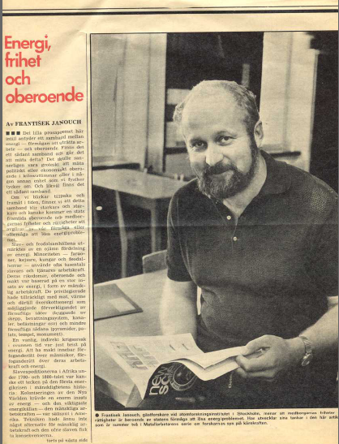
ENERGY,
FREEDOM,
INDEPENDENCE
by
František Janouch
Published in 1975
In Swedish in
Metallarbetaren

Slide 6
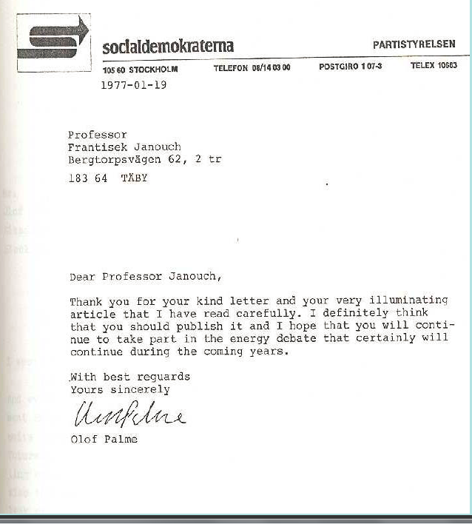

Slide 7
Mr. Donald J. Johnston,
Secretary General of OECD,
Pamplona, Spain in April 2002:
• It will require policy leadership to bring energy
to the top of the policy agenda and to keep it there
• It will require vision to anticipate problems well
ahead of time so that they can be addressed in
an orderly manner
• It will require political courage to make difficult
choices, notably for the trade-offs between the
welfare of the present versus future generations.

Slide 8
ENERGY PRIMER
A HANDBOOK FOR POLITICIANS,
MY GREEN FRIENDS
AND FOR US,
THE CITIZENS OF THE PLANET EARTH

Slide 9
Primer, Букварь, Abécédaire, Lesebuch oder Fibel, Slabikář, ABC-bok
prim-er [1] (prim'uhr; esp. Brit. prie'muhr) n.
1. an elementary book for teaching children
to read.
2. any book of elementary principles.
[1350-1400; ME < ML primarium, n. use of neut. of
primarius PRIMARY]
prim•er (prim¿€; Brit prïm¿€r)

Slide 10
THE TEN ENERGY COMMANDMENTS
1. Physics know only one source of energy:
NUCLEAR energy. Energy is produced in nature ONLY in fusion of light nuclei or fission of heavy nuclei.

Slide 11
THE ORIGIN OF OUR ENERGY SOURCES
Solar Energy Synthesis of Light Nuclei
Geothermal Energy Radioactive Decay
Wind Energy Sun
Hydro Energy Sun
Wave Energy Wind →Sun
Fossils Stored Solar Energy
Biomass Photosynthesis → Sun
Tidal Energy Gravitation, Big Bang

Slide 12
THE TEN ENERGY COMMANDMENTS
2. Most raw materials used by mankind can by substituted by some other material(s). This is not valid for energy. Energy can not be substituted or replaced. Energy can be only conserved,
transformed, one can save it or waste it.
The energy conservation and transformation laws belong to the most fundamental laws in of nature discovered and confirmed already in XIX. Century
or even earlier.

Slide 13
ENERGY CONSERVATION AND TRANSFORMATION
First Law of Thermodynamics
Robert Mayer (1844 - 1878)
Herman Helmholz (1821 – 1894)
Second Law of Termodynamics
Sadi Carnot (1796 – 1832)
Robert Clausius (1822 – 1888)
Perpetuum Mobile (Perpetual motion)
The Frend Academy of Science decided already in 1775 not to waste time by considering different proposals of Perpetuum Mobile
Finally: Albert Einstein (1879-1955) E= m.c²

Slide 14
THE TEN ENERGY COMMANDMENTS
3. Humankind uses energy extremely unevenly:
Only 16% of population uses over 49% of energy,
84% of mankind uses only 42% of electricity.

Slide 15
World Disproportions
Population
Energy Consumption
Eletricity Consumption
Rich 16%
Rich 49%
Rich 58%
Poor 84%
Poor 51%
Poor 42%
84% = 5 554 000 000 people (2009)
World Bank WDI 2006

Slide 16
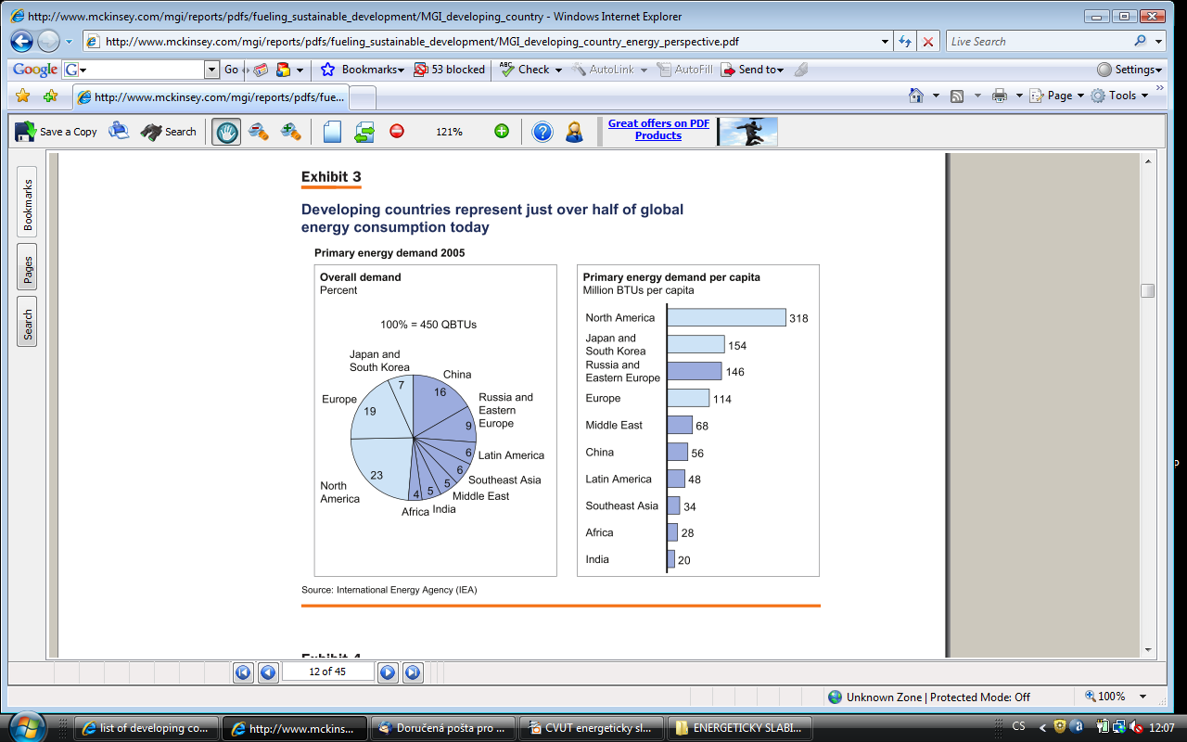
prim-er [1] (prim'uhr; esp. Brit. prie'muhr) n.
1. an elementary book for teaching children
to read.
2. any book of elementary principles.
[1350-1400; ME < ML primarium, n. use of neut. of
primarius PRIMARY]
prim•er (prim¿€; Brit prïm¿€r)

Slide 17
THE TEN ENERGY COMMANDMENTS
4. GDP and several other important „civilization“ indicators, as e.g. life expectancy of infant mortality, are related to the amount of energy disposed by the society.
Mankind, therefore, have has to expect a considerable increase in energy consumption.

Slide 18
Energy and the „Quality“ of Life
 | World | High income states | Middle income states | Low income states
Population (mil.) | 6534 | 1048 | 4217 | 1268
Energy use (kg of oil equivalence per capita) | 1820 | 5416 | 1267 | 478
Electricity consumption (kwh per capita) | 2751 | 9675 | 1651 | 309
GDP in bil. $ | 48 863 | 37079 | 11102 | 700
Life expectancy (years) | 67 | 79 | 65 | 56
Infant mortality | 49,4 | 5,2 | 35,7 | 92,7
World Bank WDI 2006
Notes:
18

Slide 19
GDP per capita (in current USD)
OECD versus countries of South of Sahara
 | World | Sub-Sah. Africa
1981 | 9270 | 710
1991 | 17578 | 582
2001 | 20474 | 485
2006 | 34735 | 920
World Resources Intitute 2008

Slide 20
THE TEN ENERGY COMMANDMENTS
5. Energy is even related to such abstract terms as “freedom“ or “independence“.

Slide 21
THE TEN ENERGY COMMANDMENTS
In physics time and energy are always closely connected.
Uncertainty relation in quantum physics even suggests a certain link between energy and time:
ΔE x Δt ~ h

Slide 22
The more energy you have at your disposal, the more and the faster you can perform different activities.
Possessing only one „horse power“ a trip from
Paris to Stockholm took a week or two. Using a modern jet (and using tens of thousands of horse-powers) you cover the same distance by two hours.
Cultivating one acre by hands would take several days. By using a horse you can do it in several hours. A tractor (hundreds of horse powers) will shorten the necessary time to a fraction of a hour!

Slide 23
THE TEN ENERGY COMMANDMENTS
5. Until now we have not succeeded the population explosion: the population of our planet increases monthly by 250 000 people.

Slide 24
Population Clock
World population
6 930 750 845 5 Dec 2011 22:30 GMT
6 859 705 191 5 Dec 2010 22:30 GMT
71 045 654 netto increase per year
Over 5 millions/month
194.520 per day

Slide 26
Energy consumption in different states and regions
Country / Region | Energy consumption (kg of oil equivalent per cap
World | 1,778.0
Europe | 3,773.4
North America | 7,942.9
Developed Countries | 4,720.0
Developing Countries | 975.9
Japan | 4,135.3
USA | 7,885.9
Canada | 8,472.6
United Kingdom | 3,894.6
IEA 2005

Slide 27
To conclude
To cover the growing energy need
(due to the demographic explosion only)
We need to introduce daily electricity generating capacities by
392 MW(e)!!
In other words: To keep the same energy standard (discrepancy),
It would be necessary to put
One Chernobyl (or Temelin) reactor
Into operation every two and half day.
(assuming average energy consumption 1.8kw(e) per capita)

Slide 28
THE TEN ENERGY COMMANDMENTS
7. At present more than 80% of all consumed energy is obtained by burning fossil fuels.

Slide 29
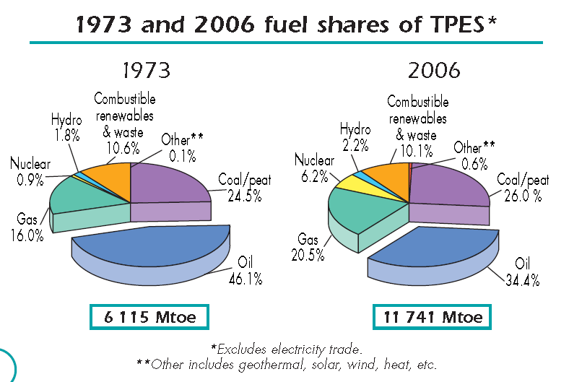
World TPES
IEA 2008

Slide 30
World electricity generation by source of energy
1971
2006
5245 TWh
18930 TWh
OECD Factbook 2008

Slide 31
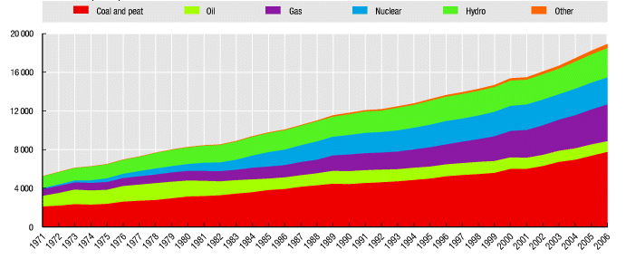
World electricity generation by source of energy
Time serie by TWh
OECD Factbook 2008

Slide 32
THE TEN ENERGY COMMANDMENTS
8. Fossil fuels were produced during hundreds of millions years by absorption of carbon dioxide from the atmosphere. By means of photosynthesis reaction oxygen was released into atmosphere while carbon was store in the biomass.
9. If fossil fuels are consumed at current pace, their supply would be almost exhausted during a couple hundreds of years (IEA 2008: oil in 200 years, coal in 300 years)

Slide 33
THE TEN ENERGY COMMANDMENTS
10. Already today carbon dioxide is being released into atmosphere by burning fossil fuels million times faster than it was, some hundred million years ago, absorbed from the atmosphere.

Slide 34

THE TEN ENERGY COMMANDMENTS
CO2
300 000 000 years

Slide 35
THE TEN ENERGY COMMANDMENTS
CO2
300 (?) years

Slide 36
Renewables
Be careful with prognoses!

Slide 37
Swedish 1978 Projection for 1989 and the 1993 reality (Renewable Resources)
 | Solar (TWh) | Wind (TWh) | Biomass (TWh)
1989 projection | 3 | 2 | 5
1993 reality | 0,0001 | 0,05 | 0,1
Remark: Swedish NPP are producing about 75 Twh of electricity per year!!!

Slide 38
Sweden and Nuclear Energy
Own model of BWR
Built 12 reactors providing about 45% of electricity
1979 referendum
1980 Riksdag decission to stopp all nuclear reactors by year 2010(?)
Years 2009 nuclear reactors still contributing about 42-3% of cheapest electricity

Slide 39
2009 the Riksdag decided to allow
continuation
of nuclear power and
to replace the old reactors
to be comissioned

Slide 40
The global increase of electricity production
This is the proportion of electricity production above the level 1989
in spite of the heavy state subsidies
OECD Factbook 2008

Slide 41
During the nineties the global increase of electricity production from renewables was several times smaller than the global increase of
electricity consumption or production!!!!

Slide 42


Slide 44
Andrey Sakharov:
Nuclear Energy
and
the Freedom of the West
(Written in December 1977!!!)

Slide 45
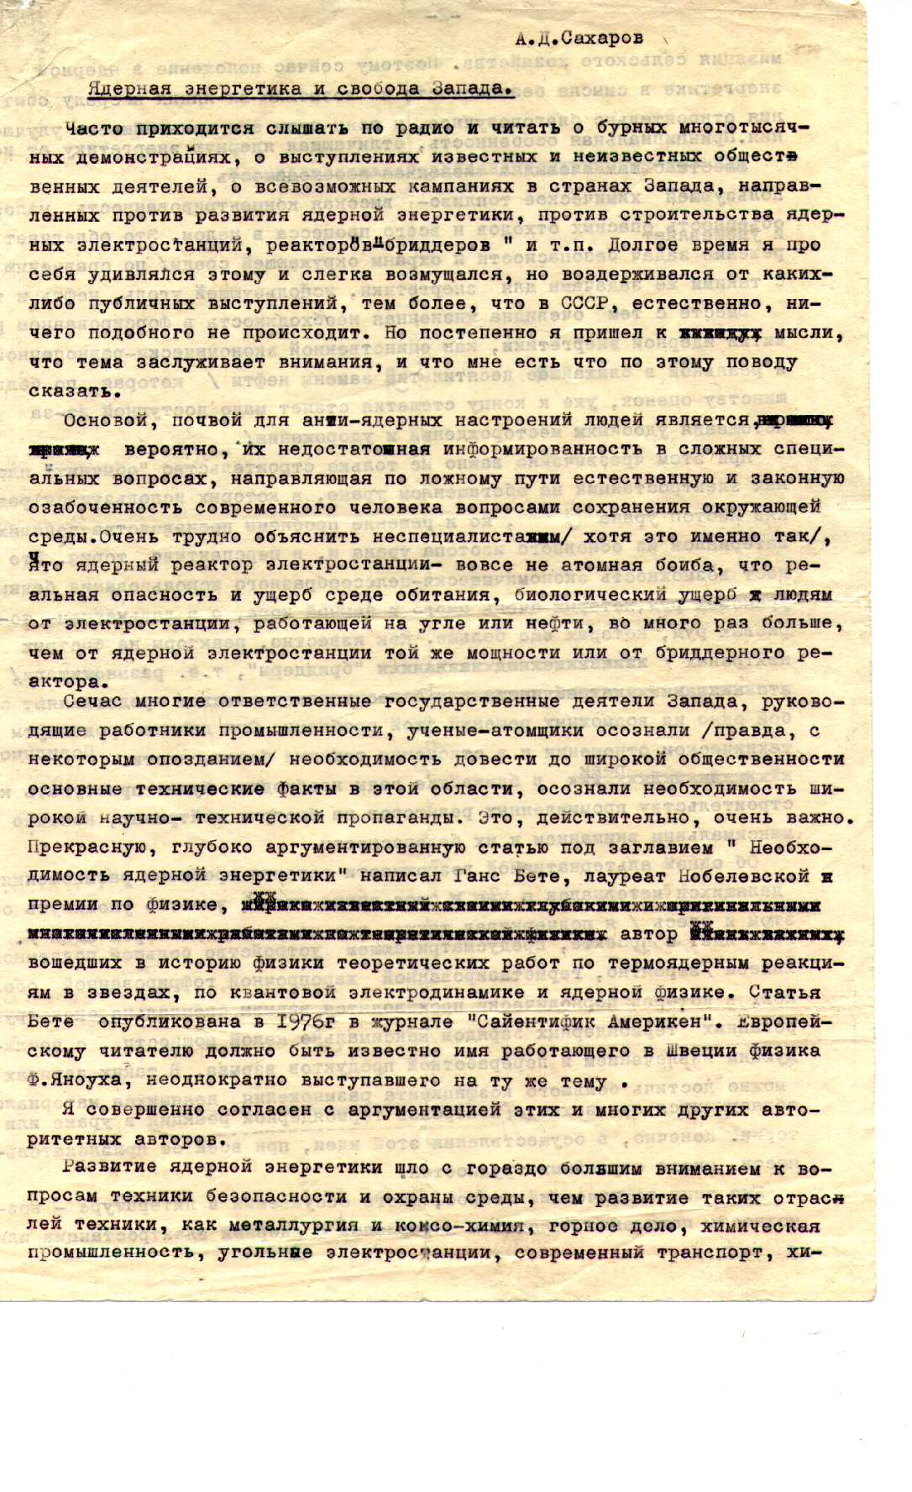
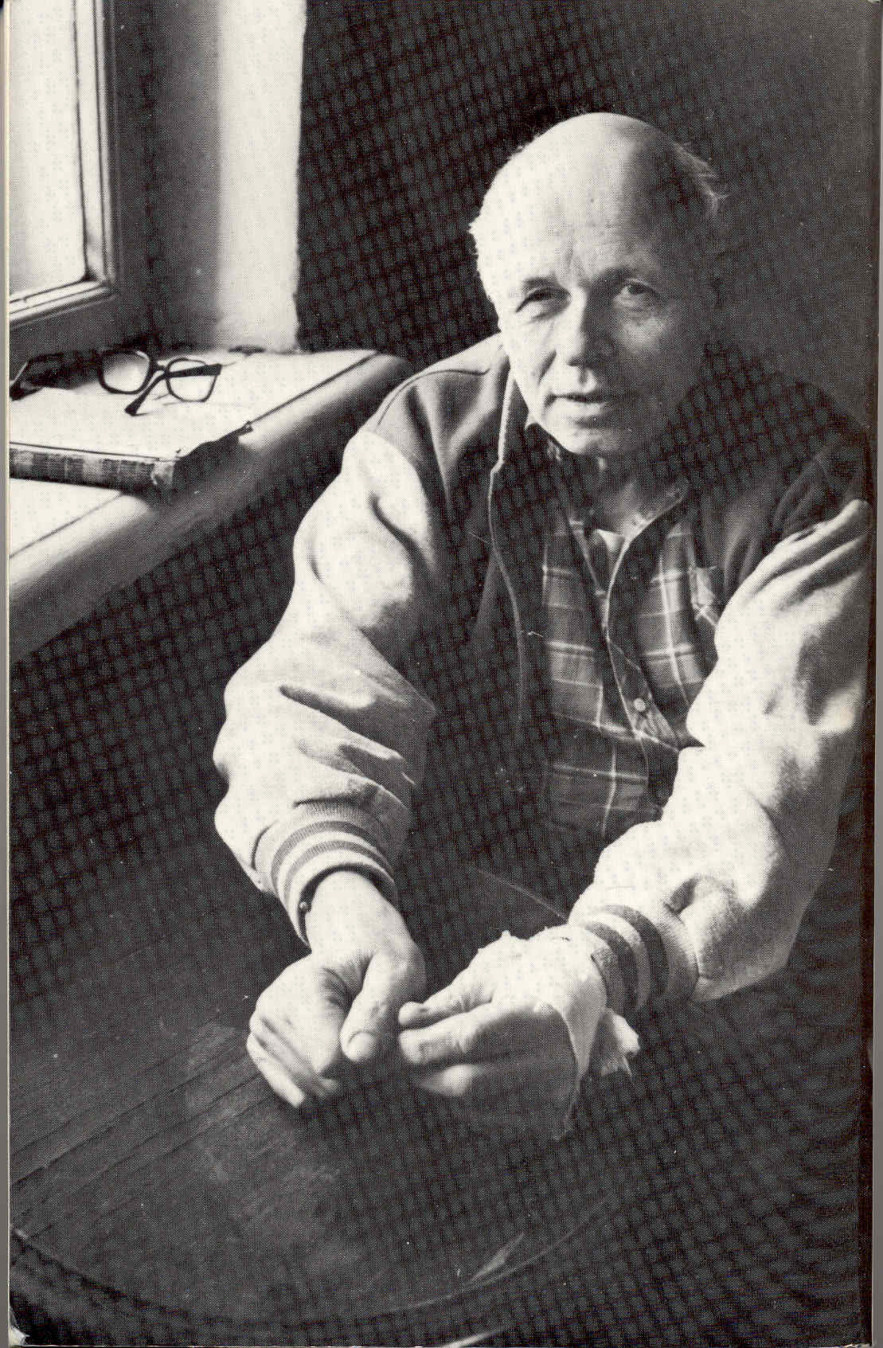

Slide 46
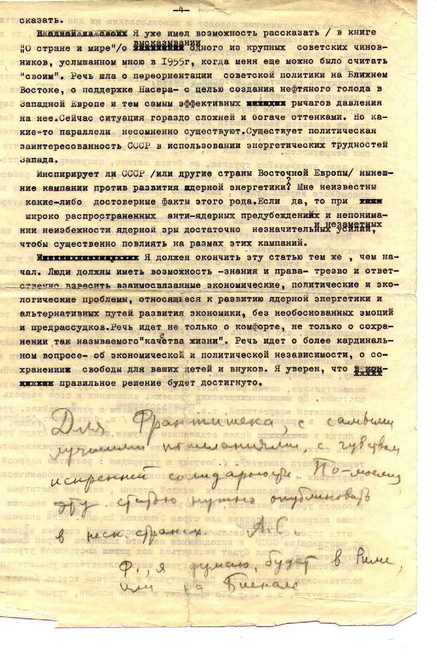

Slide 47
ifIf we continue to develop our energetics in such an irresponsible way we migh happen to end in the following situation…

Slide 48
SoSonst sehen wir, dass wir sehen nichts
Jinak vidíme, že nic nevidíme
Otherwise we see that we see nothing

Slide 50
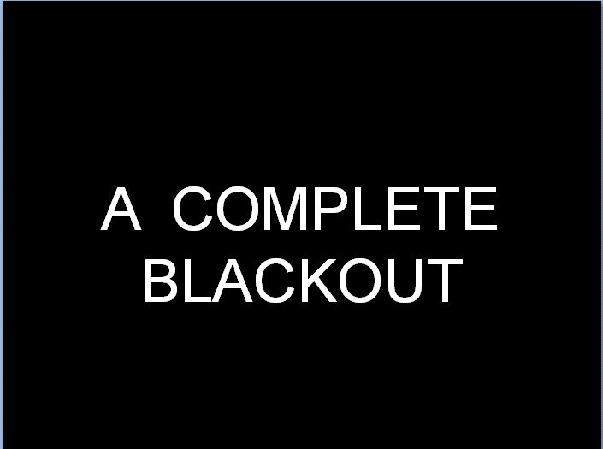
The previous slide presented …
A COMPLETE BLACKOUT

Slide 51
BLACKOUT IN THE
STATE OF NEW YORK

Slide 52
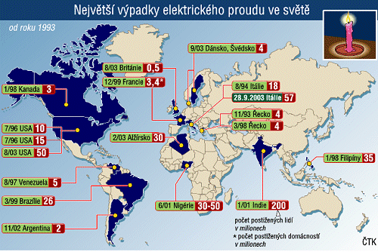
Largest blacouts in the world since 1993

Slide 53
EU-27 IS A NUCLEAR POWER
EU-27 is the largest „nuclear power“ in peaceful use of nuclear energy
EU-27 produces some 8% more nuclear electricity than North America, 3 times more than Japan and almost 7 times more than Russia
Only 4 states in the world cover its electricity consumption by more than 50% by NPP – all four belongs to EU-27

Slide 54
Nuclear Power in EU-27
Provides 35% of electricity consumption
Posseses a high level of safety
Is the the cheapest way of electricity production
Investments are already mostly amorted
Nuclear energy has a very stable structure of costs
NPP plant can be (and are!) modernized at very reasonable costs
Contributes to creation of highly specialized and highly qualified centra (high-technology centres)
Eliminates import risks (energy security)

Slide 55
European Union - 27
12+4 Countries are using Nuclear Energy:
Bulgaria, Czech Republic, Finland, France, Lithuania, Hungary, The Netherlands, Rumania, Slovakia, Slovenia,Great Britain and Switzerland (not EU)
4 Countries are planning to phase out nuclear energy:
Belgium, Germany, Spain, Sweden
4 (5) States are planing to build NPP
Estonia, Latvia, Poland, Italy, Turkey (not yet EU)

Slide 56
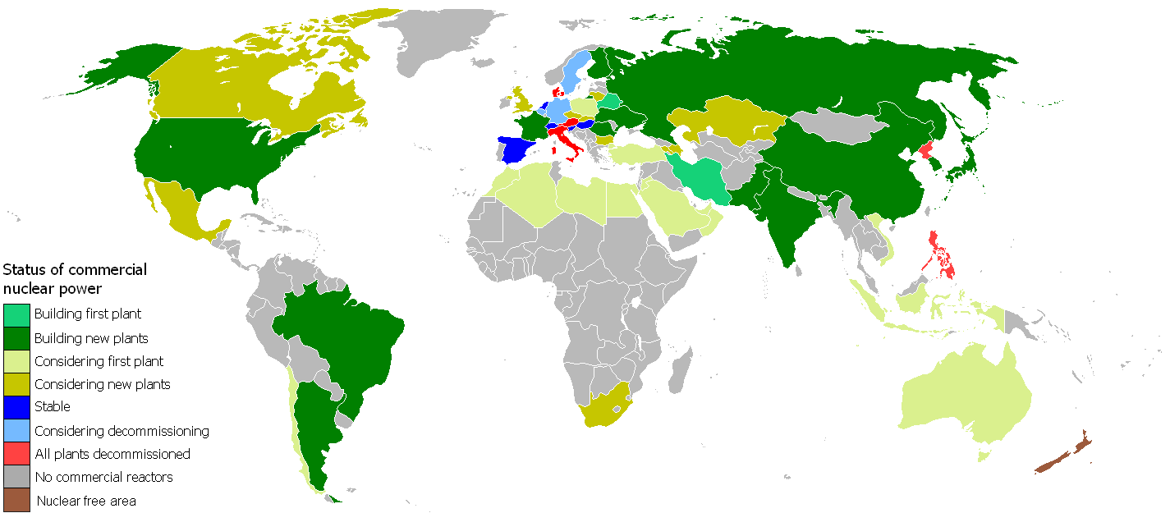
Nuclear energy worldwide

Slide 57
Facts and figures:
Facts give us a clear message:
At the end of 2007 439 nuclear power reactors with total output 372 GW(e) were in drift. Simoultaneously, however, under construction, projection, preprojection or deliberations were 349 nuclear power plants with output of ≈ 321 GW(e).

Slide 58
Rennesaince of Nuclear Power
Problems of two kinds:
A. Political climate and damnation, stigma NP is carrying with (Hiroshima, Chernobyl, Fukushima, Germany, greens, coalitions, old commitments etc)
B. Manufacturing capacity, maintaince, operational staff, new specialists etc. (AREVA? Sweden? Westinghouse etc.)

Slide 59
ENEF
Prague,
22-23 May, 2008
WELCOME

Slide 60
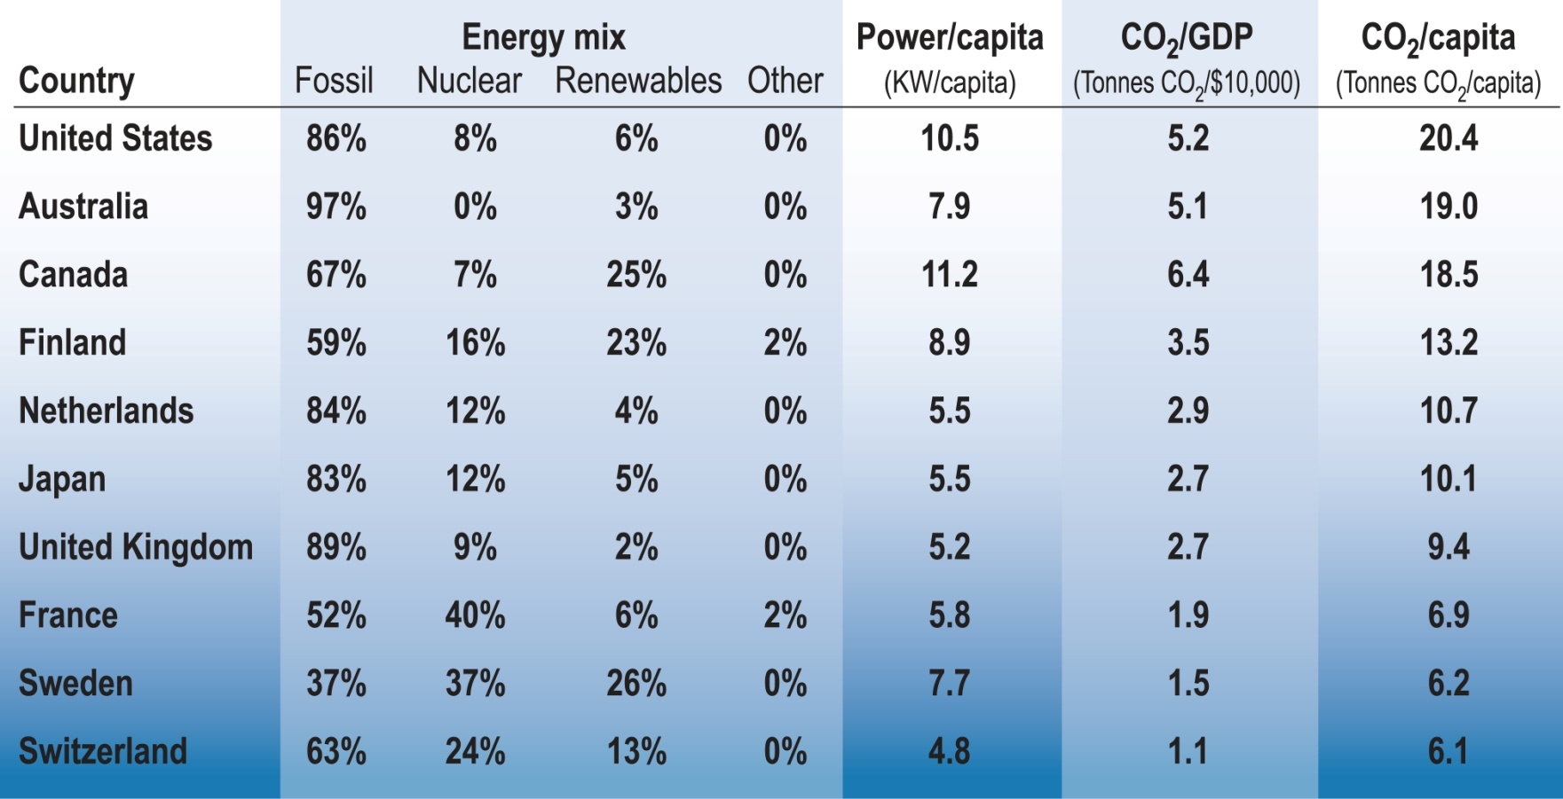
Energy mix, energy use and CO2 emissions by GDP and by population
Nuclear energy and other clean energy sources are key to sustainable development
60

Slide 61
French Advanced Reactor Strategy
Strategy approved by Ministries of Research and Industry (Mar 2005)
Announcement of President Chirac launching the design of a prototype Gen IV reactor to be commissioned in 2020 (Jan 2006)
Bill on Sustainable Management of Radioactive Waste called for an assessment of the industrial prospects for these reactors by 2012, and to put a prototype into operation by 2020 (June 2006)
61

Slide 62
French Advanced Reactor Strategy
Development of fast reactors with a closed fuel cycle:
Sodium Fast Reactor
Gas Fast Reactor
New processes for spent fuel treatment and recycling
Nuclear hydrogen production and high temperature process heat supply to the industry:
Very High Temperature Reactor (VHTR)
Watersplitting processes for hydrogen processes, synthesis of hydrocarbon fuels, process heat...
Innovations for LWRs (fuel, systems, etc.)
62

Slide 63
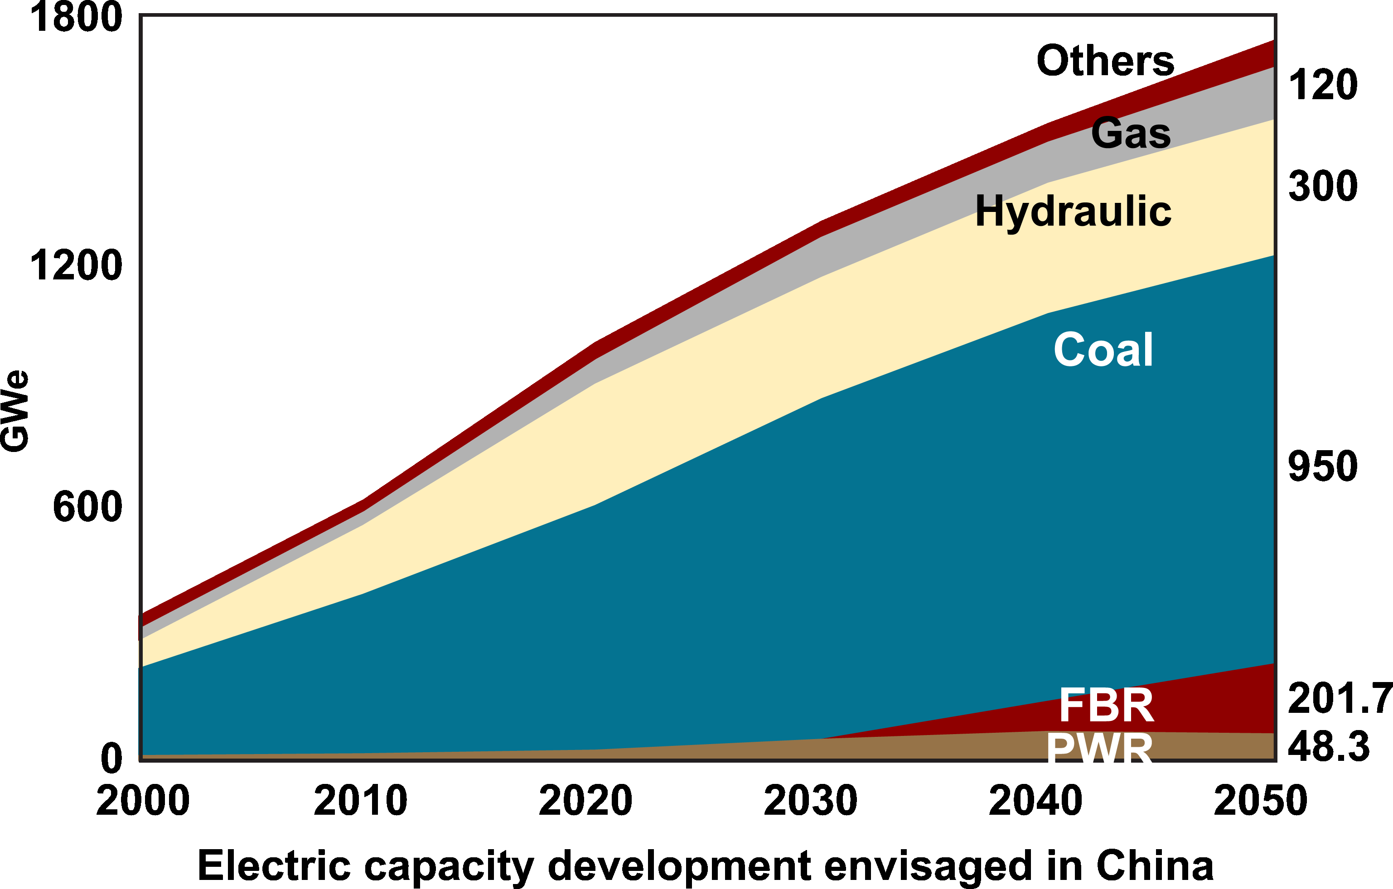
Chinese Energy Plans
China has limited uranium resources (60,000 MT – 1% of world reserves)
Ministry of Science & Technology (MOST) 2006
63

Slide 64
Chinese Fast Reactor Development
Facility | Location | Status | Fuel | Burnup (MWD/kgU) | Power (MWe)
CEFR | China | 2008 | UO₂ MOX | 60~100 | 25
CPFR | China | 2020 | MOX Metal | 100~120 | 600
CDFR | China | 2025 | Metal | 120~150 | 1000~1500
CMFR | China | 2030 | MOX+Ac Metal+Ac | 100 | 4 x 300~600
CCFR | China | 2030~2035 | TBD |  | 1000~1500
(CEFR) - China Experimental Fast Reactor
(CPFR) - China Prototype Fast Reactor
(CDFR) - China Demonstration Fast Reactor
(CMFR) - China Modular Fast Reactor
(CCFR) - China Commercial Fast Reactor
Ministry of Science & Technology (MOST) 2006
64

Slide 65
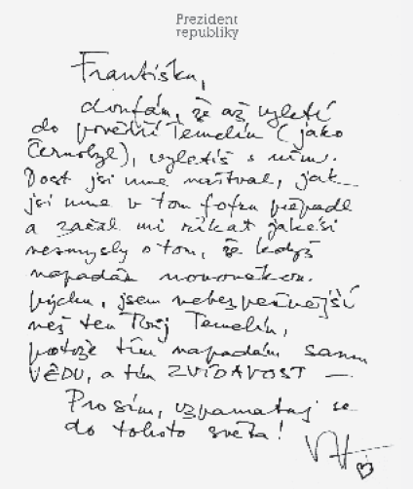
17.10.2000

Slide 66
THE END

Slide 67
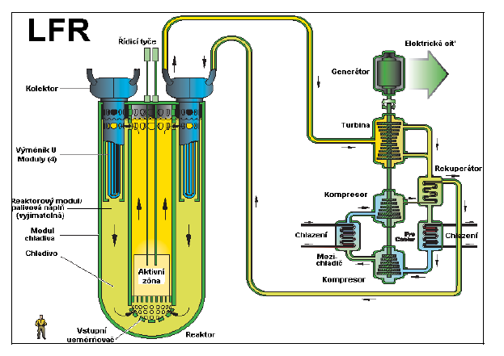

Slide 68
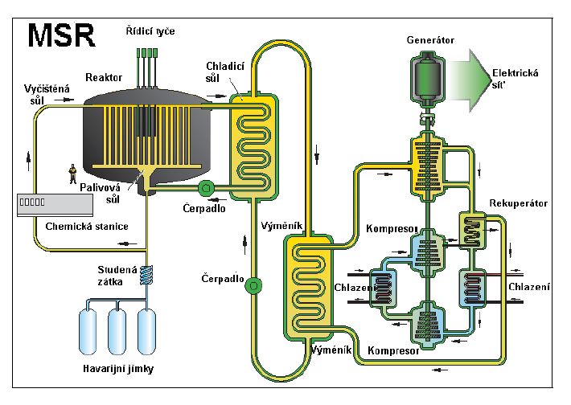

Slide 69
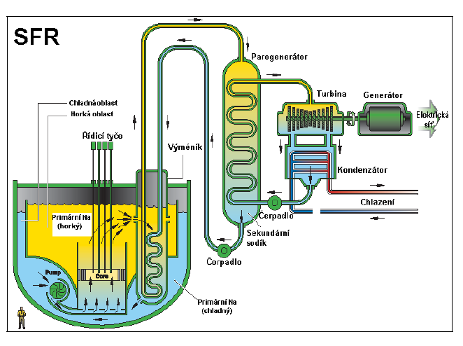

Slide 70
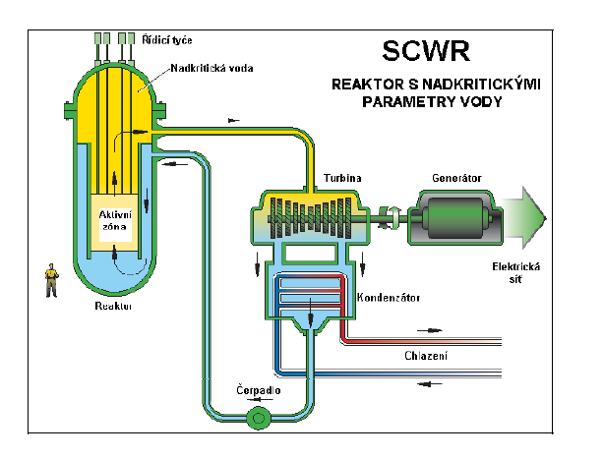

Slide 71
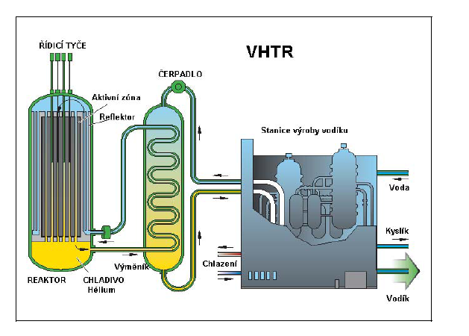
Notes:
71

Slide 72
SEVEN LARGEST ENERGY SINS?

